Slide 1

Careers in Marketing
Predicting Possible Marketing Careers With Skill Trees
Adriel Casellas
12-08-2017

Slide 2
Agenda
Context and Questions
Data Overview
Exploratory Data Analysis (EDA)
Data Adjustments
Decision Tree
Results
Findings and Implications

Slide 3

BYU Marketing Majors
Limited enrollment program of 90 students each semester
59% acceptance rate
Top recruiters include Nielsen, Frito-Lay, and Qualtrics
Teaching focus on marketing strategy, branding, and research

Slide 4
Marketing Careers
Context
Context
Marketing is a very broad field with three main career paths: sales, digital, and analytics
Issue
Many marketing students are unaware of how to prepare or even choose a career path.
Implication
Educate marketing students on the different marketing career options, how they compare, and what skills apply to each

Slide 5
Research Goal:
Understand which skills are most important in different marketing jobs, and how a student can prepare for a certain career path.
Method:
Random forest decision trees

Slide 6



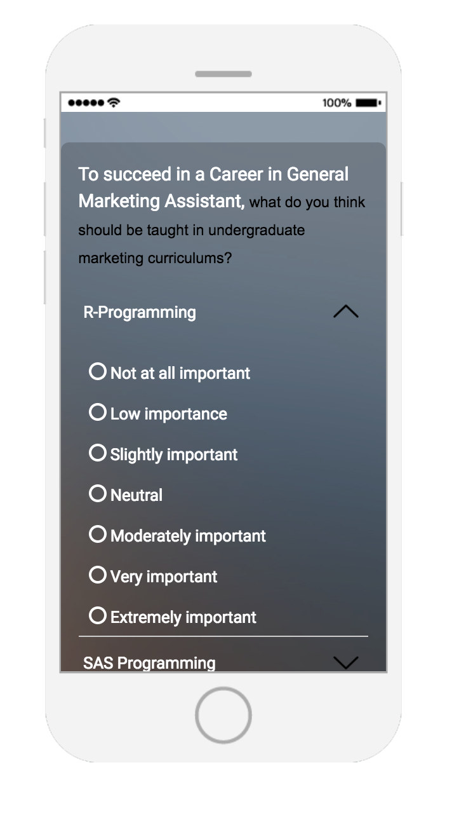
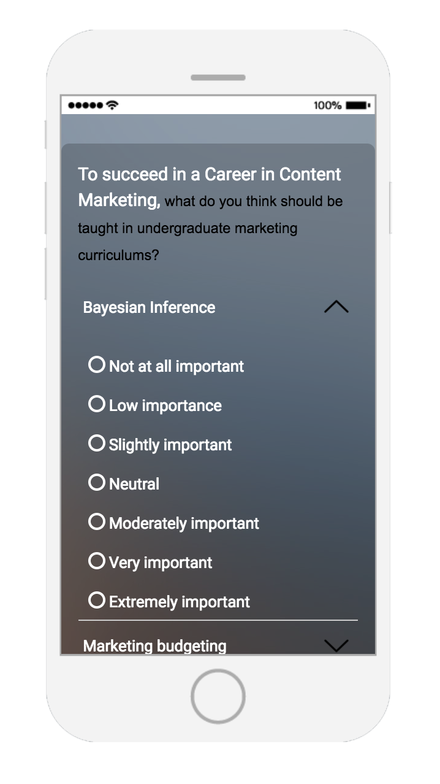
Source of Data: Survey
Factor Valuation for
Second Job (optional)
Context
Data Overview
Classifiers
Job Selection
Factor Valuation

Slide 7

Survey Responses
Context
Data Overview
961 respondents
Both students and professionals
Facebook and LinkedIn was the largest sources
Categorical
Quantitative
The job of which the respondent is familiar
Gender
Schooling status (student, industry, professor)
Skill importance measures (not important at all == 0, extremely == 7)
Year of birth
Marketing and Advertising similarity score

Slide 8

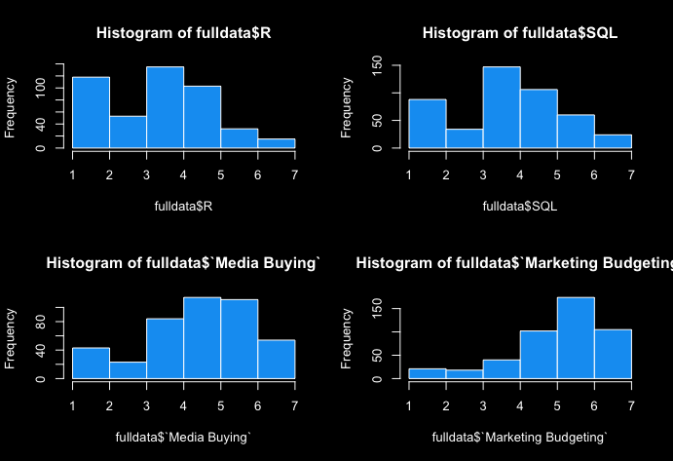
Exploratory Data Analysis
Context
Data Overview
EDA
Importance scores are not normal

Slide 9
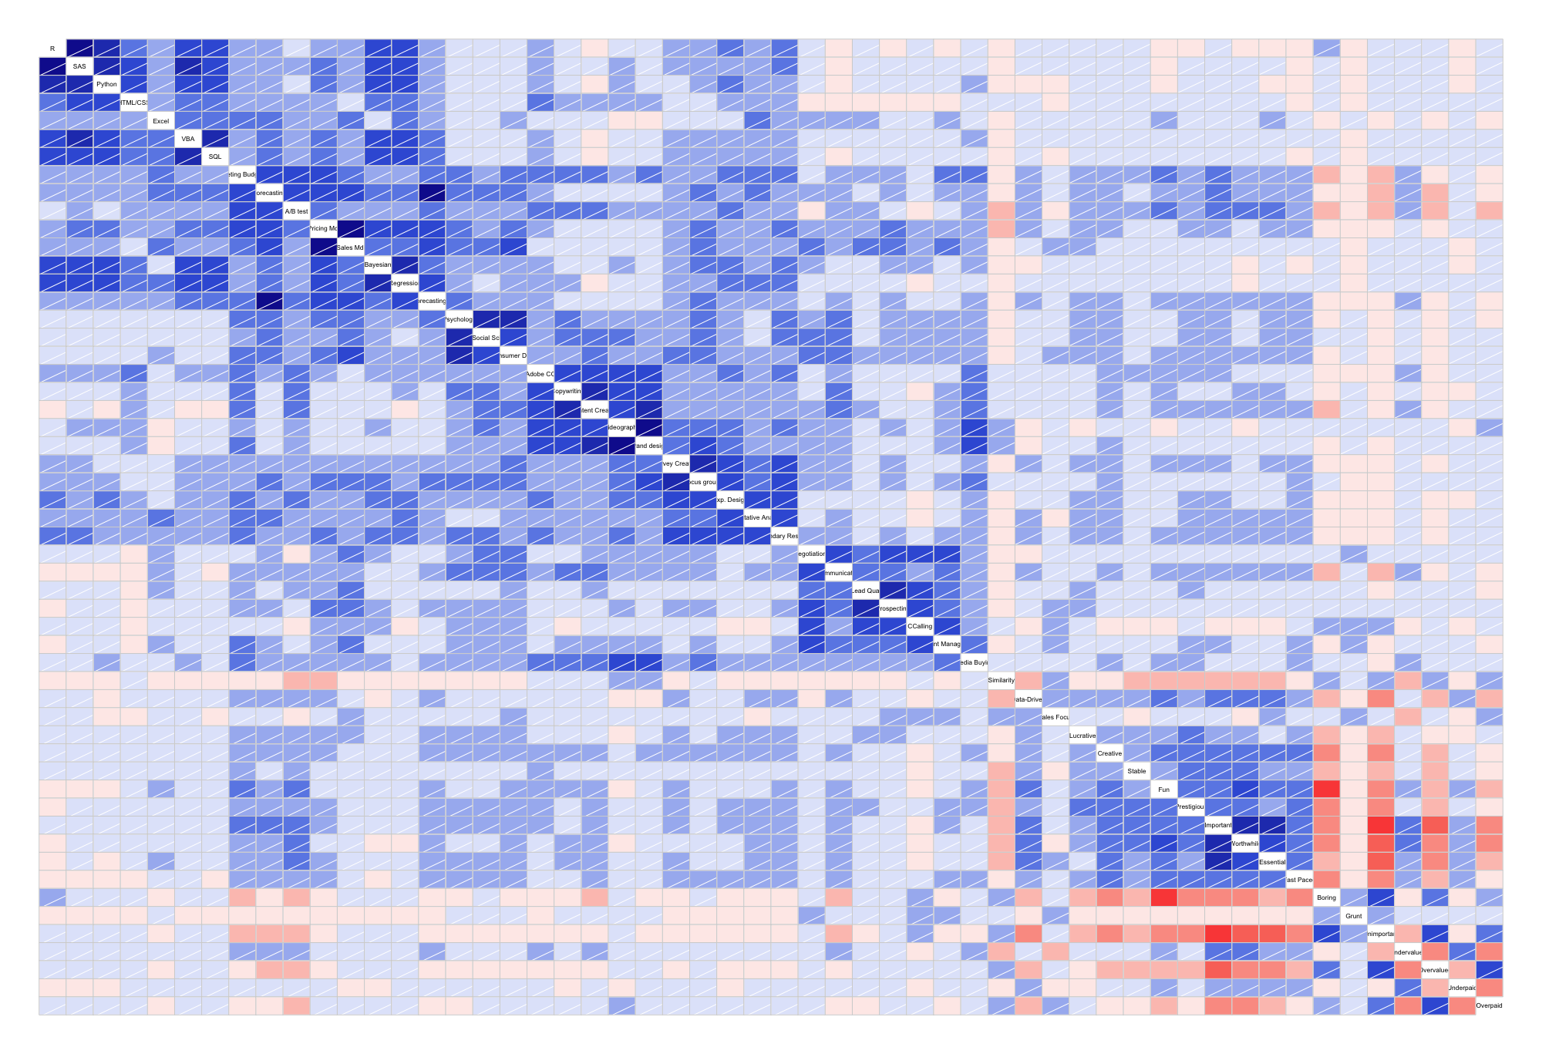
Exploratory Data Analysis
Context
Data Overview
EDA
Corrgram: blue is positive and red is negative cor
Interesting insights:
Respondents view of marketing as being “important” is positively correlated with their opinion on the importance of learning the following skills: forecasting, budgeting and A/B testing.
A higher percieved importance of learning R for marketing is more positively correlated with a “boring” perception of marketing than is true for Python or SAS.

Slide 10

Data Adjustments
Context
Data Overview
EDA
Data Adjustments
Clean out all of the incomplete survey responses. If they are more than 60% done then they are left in
Adjustments for PCA data only
Center all of the observations about zero (normalized)
Compute the covariance matrix, Σ (how do factors interact?)
Multiply vectors by Σ to “stretch” variance
Data for Random Forest is already prepared

Slide 11

The Random Forest Algorithm
Context
Data Overview
EDA
Data Adjustments
Model
Decision trees are built out by examining at which point a variable will have the largest effect on the prediction
Once a split is made in the tree, a random subset of the remaining variables are used to build the tree.
Often sqrt(p) is used to calculate the number of predictors (p) used
This is done multiple times, and the average of the trees is used as the final model

Slide 12

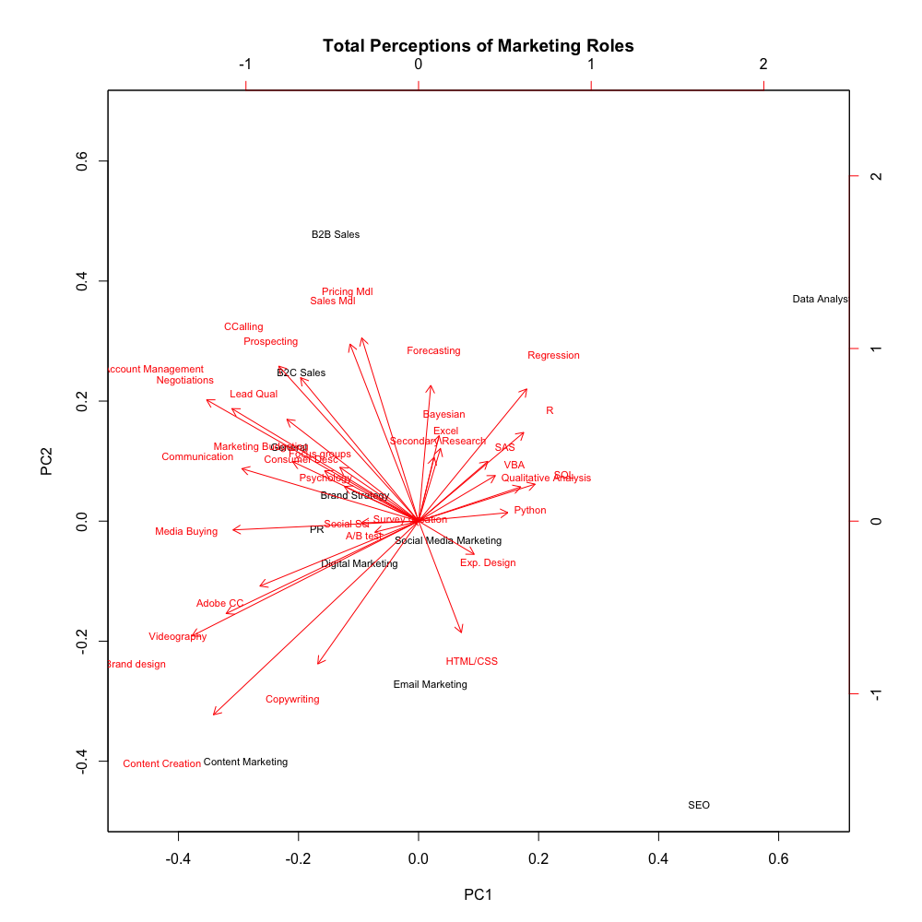
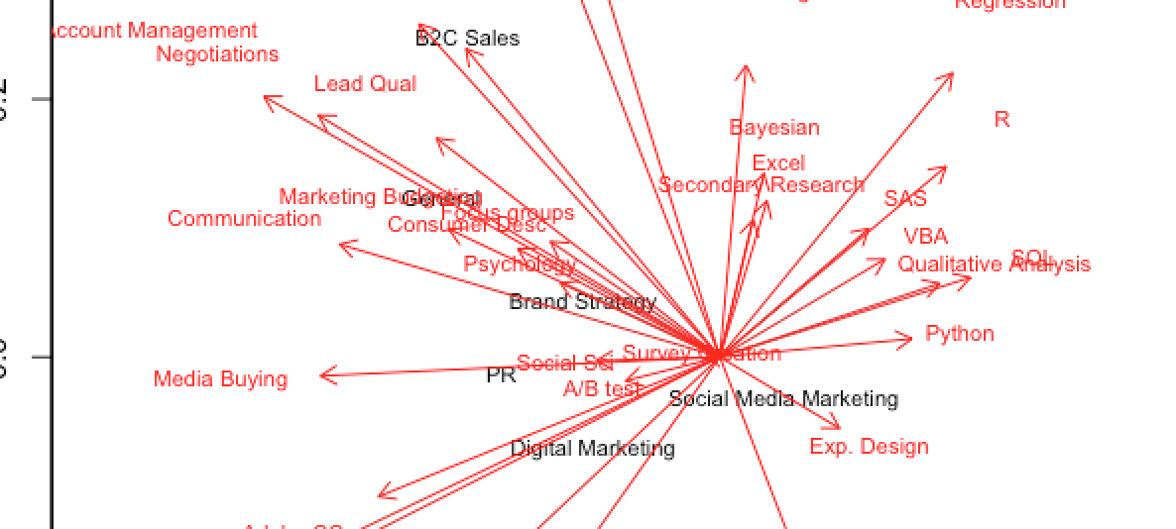
PCA Results
Context
Data Overview
EDA
Data Adjustments
Model
Results
Interpretation
PC1(X-axis): How technical the skill is
PC2 (Y-axis): How business critical the skill is
Insights:
One of the most critical marketing roles, brand strategy, seems to be very versatile (or not clearly defined).
There appears to be four career groupings

Slide 13
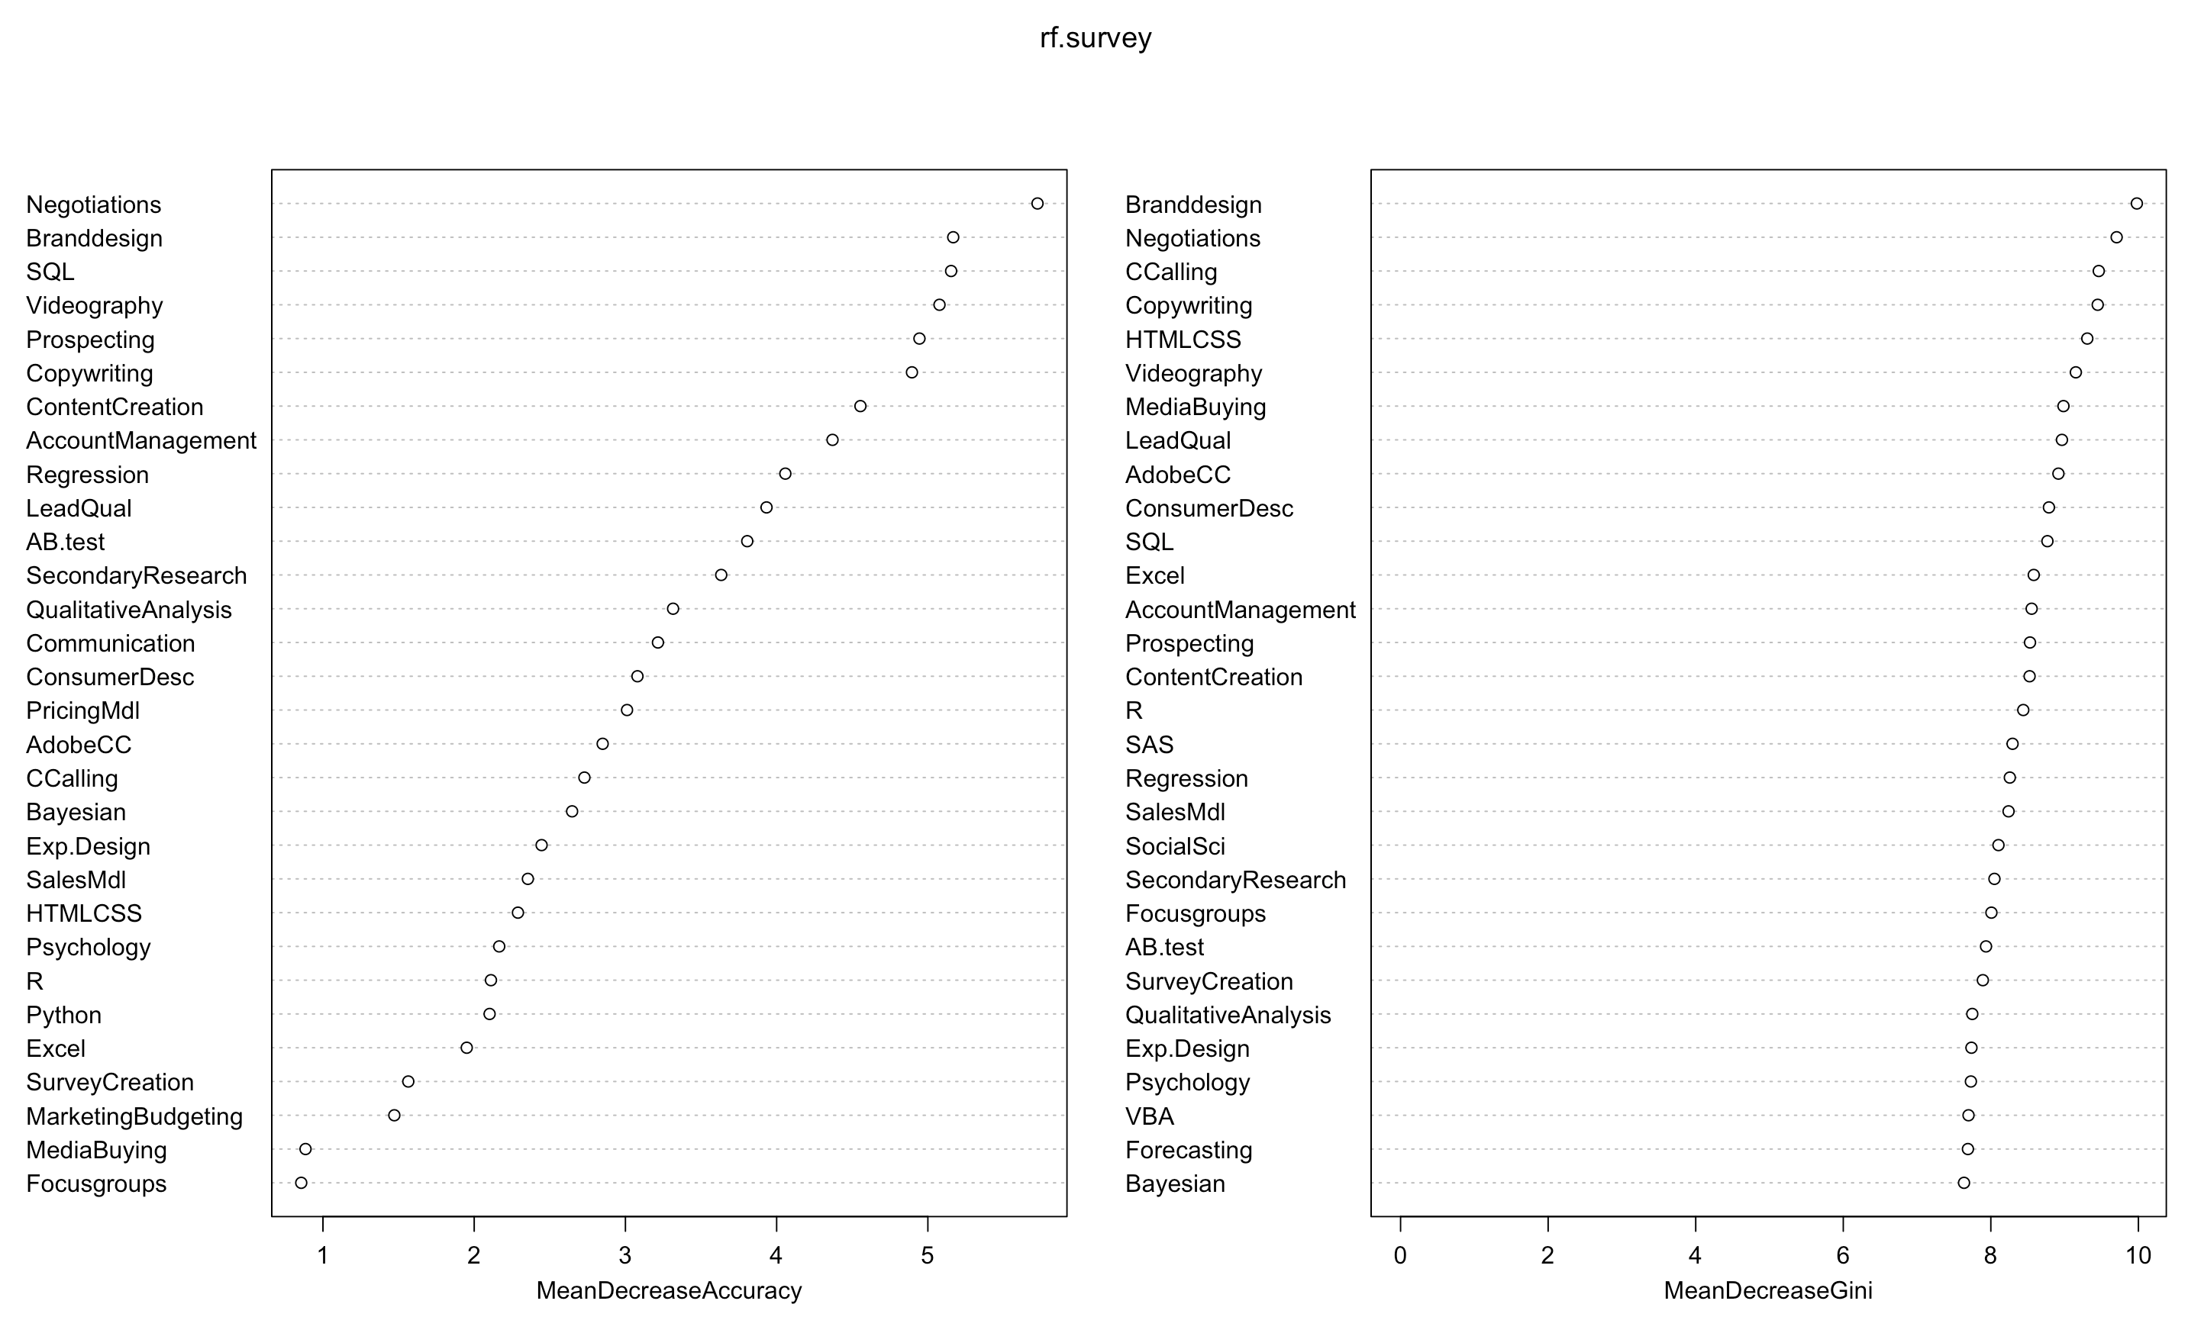
RF Results
Random Forest predicting for each career type
Context
Data Overview
EDA
Data Adjustments
Model
Results
Interpretation
Interestingly, skills in negotiations seemed to be the most important when determining what career fits best with the skills a student may have or be interested in learning.
SQL seems to be more of a decider (likely for the Analyst position)

Slide 14
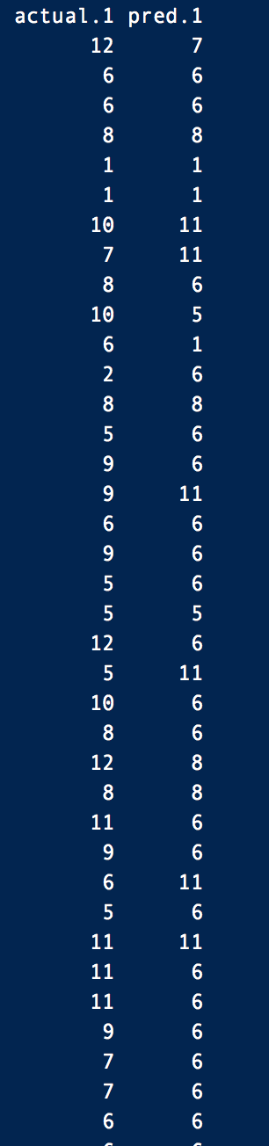
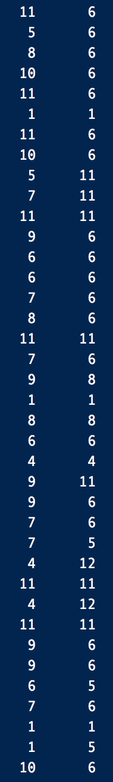
RF Results
Random Forest predicting for each career type
Context
Data Overview
EDA
Data Adjustments
Model
Results
Prediction accuracy was 70%
The top predictors for what job matched with certain skills were skills that were more strategic in nature. These included skills such as brand design and negotiations, which are more high level compared to skills such as Adobe Creative Cloud and R, which are more tactical in nature.

Slide 15

Findings
Context
Data Overview
EDA
Data Adjustments
Model
Results
Findings and Implications
The PCA revealed that four career options may be more suitable for a marketing major. If the school can include more technical classes.
Marketing education should place more focus on higher level skills, given that tactical skills may be easier to teach on the job.

Slide 16
Thank you

